Slide 1

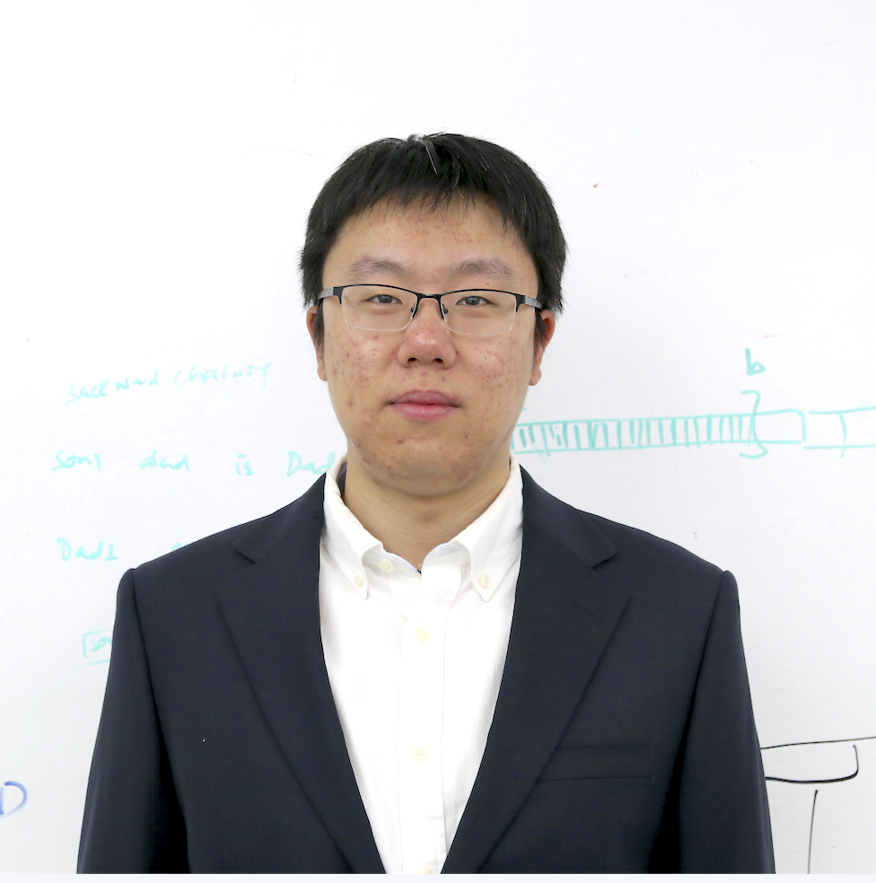

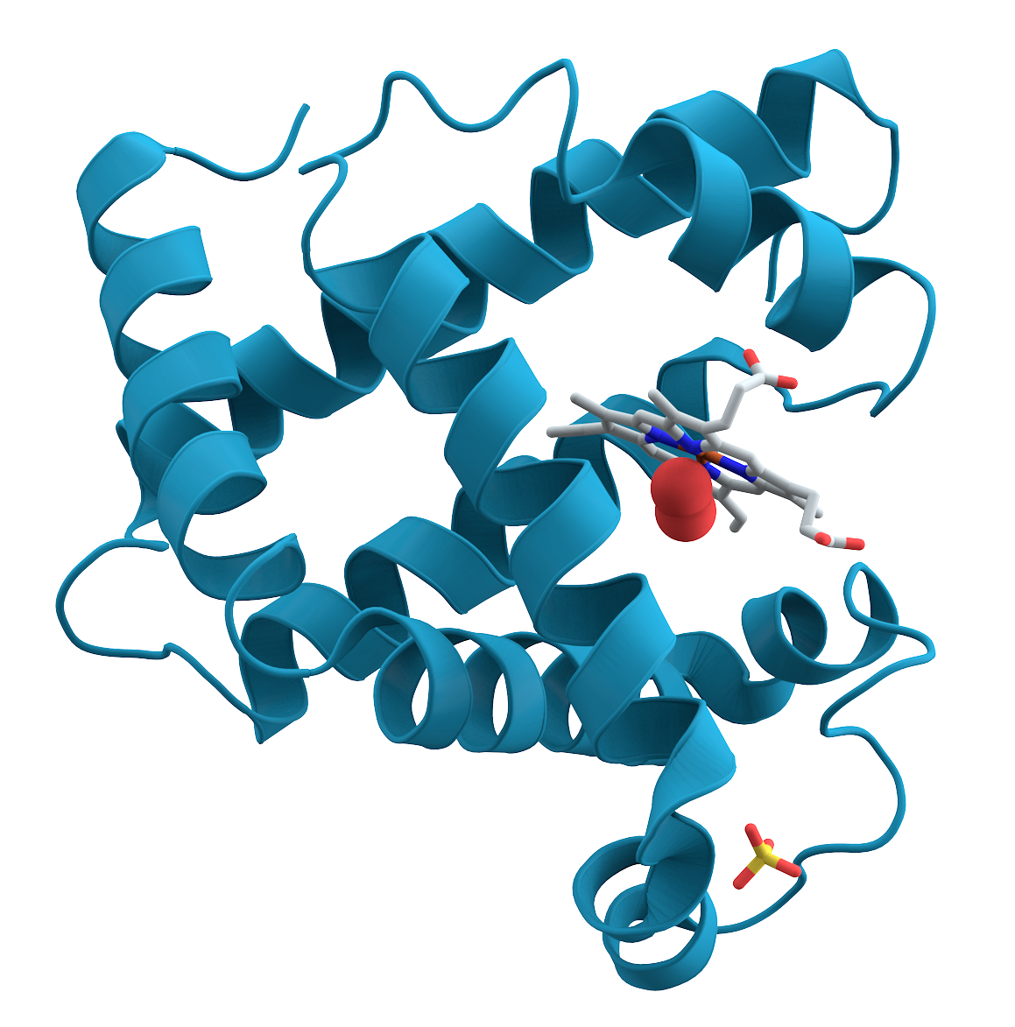
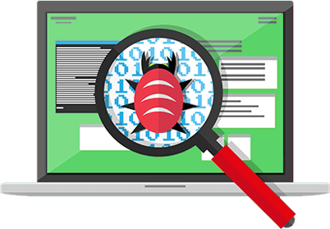





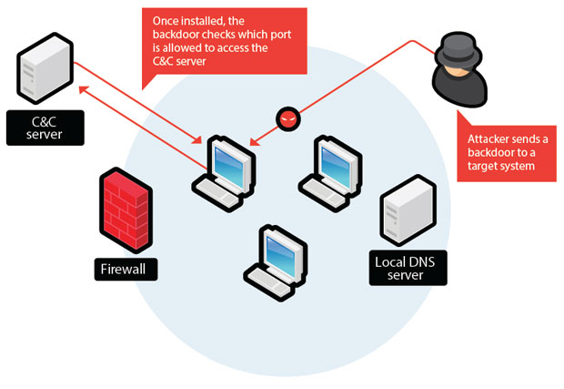
Yuede Ji (yuede.ji@unt.edu) Department of Computer Science and Engineering Assistant Professor Graph Lab: https://yuede.github.io/
Cybersecurity, High-Performance Computing, Graph Analytics, Graph AI.
Vulnerability Detection for Computing Devices (E.g., Mobile and IoT Devices)
High-Performance Computing for Graph AI and Analytics
CSE, Yuede Ji, https://yuede.github.io/
Notes:
Graph lab, 2 phd students, 1 visiting phd student
On one hand, we are trying to protect the emerging data and computing devices from various layers, such as vulnerability detection, malware detection, and network threat detection.
On the other hand, we are focusing on graph-centric high-performance computing. Graph is a very elegant data structure with nodes and edges connecting the nodes.
I believe there are many collaboration opportunities with the colleagues here. So, I look forward to that.

